Slide 1
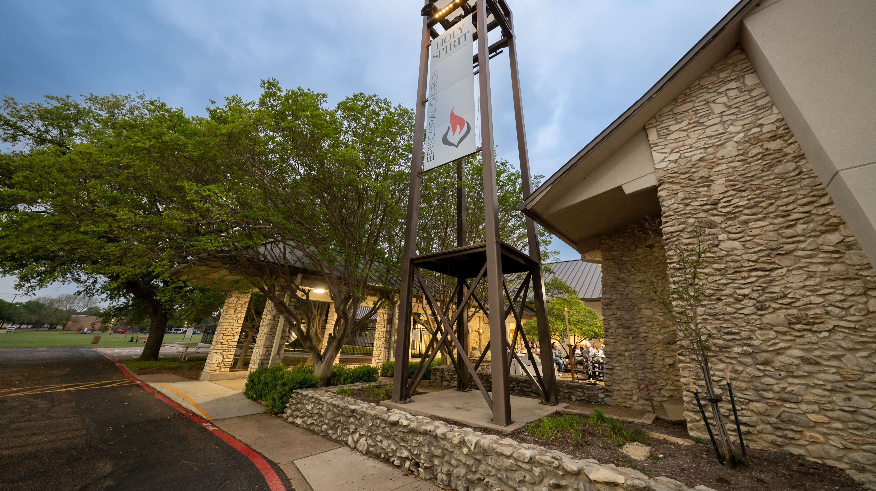
Partners, Not Patrons
Appreciative Inquiry, Planning, and Stewardship at
Holy Spirit Episcopal Church,
Waco, Texas

Slide 2
Inundated with Asks

Slide 3
Financial PARTNERSHIP grows out of shared OWNERSHIP

Slide 4
Can we make partners instead of patrons?

Slide 5
Hi.
I’m a very tired fundraiser.

Slide 6
Appreciative Inquiry

Slide 7
What if we updated the Every Member Canvas?

Slide 8
Find Your Strengths

Slide 9
Find Your Strengths
Include Your Community

Slide 10
Find Your Strengths
Include Your Community
Work It Through

Slide 11
Start asking:
What’s going well?
How can we do even better next time?

Slide 12
Financial PARTNERSHIP grows out of shared OWNERSHIP

Slide 13
Start asking:
What’s going well?
How can we do even better next time?

Slide 14
Partners, Not Patrons
Appreciative Inquiry, Planning, and Stewardship at
Holy Spirit Episcopal Church,
Waco, Texas

